Slide 1
The Unix System Interface
Jerome Blas Austria

Slide 2
Outline:
File Descriptors
Low Level I/O

Slide 3
File Descriptor
is an abstract indicator handle used to access a file or other i/o resources, such as a pipe or network socket
Integer Value | Name | <unistd.h> | <stdio.h>
0 | Standard Input | STDIN_FILENO | stdin
1 | Standard Output | STDOUT_FILENO | stdout
2 | Standard Error | STDERR_FILENO | stderr
Notes:
On Unix-like systems, the interface defined by unistd.h is typically made up largely of system call wrapper functions such as fork, pipe and I/O primitives (read, write, close, etc.).

Slide 4
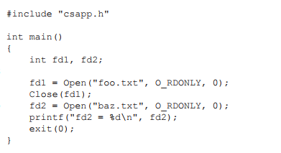
Opening and Closing Files
int open (const char *filename, int flags[, mode_t mode])
int close (int fd)
Notes:
The open function creates and returns a new file descriptor for the file named by filename. Initially, the file position indicator for the file is at the beginning of the file. The argument mode is used only when a file is created, but it doesn’t hurt to supply the argument in any case.
close() closes a file descriptor, so that it no longer refers to any file and may be reused.
If fd is the last copy of a particular file descriptor the resources associated with it are freed
close() returns zero on success. On error, -1 is returned, and errno is set appropriately.

Slide 5
flags: What is to be done by the open.
Flags | Description
O_RDONLY | Open for reading only.
O_WRONLY | Open for writing only.
O_CREAT | Create file if it does not exist.
O_TRUNC | Truncate size to 0.
O APPEND | Before each write operation, set the file position to the end of the file.
mode: Permissions with which to create a file. Used only when creating a file on an open for write.
Mode | Description
S_IRUSR | Read for owner.
S_IWUSR | Write for owner.
S_IRGRP | Read for group.
S_IROTH | Read for other.

Slide 6
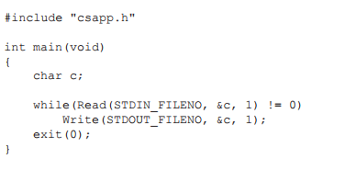
Read and Write
ssize t read(int fd, void *buf, size t n);
ssize t write(int fd, const void *buf, size t n);
Notes:
read() attempts to read up to count bytes from file descriptor fd into the buffer starting at buf.If count is zero, read() returns zero and has no other results. If count is greater than SSIZE_MAX, the result is unspecified.
write() writes up to count bytes to the file referenced by the file descriptor fd from the buffer starting at buf. POSIX requires that a read() which can be proved to occur after a write() has returned returns the new data. Note that not all file systems are POSIX conforming.

Slide 7
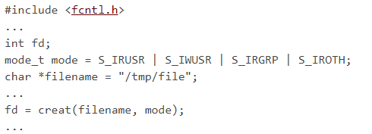
Creat and Unlink
int creat(const char *path, mode_t mode);
int unlink(const char *pathname);
Notes:
creat - create a new file or rewrite an existing one
unlink - delete a name and possibly the file it refers to
unlink() deletes a name from the filesystem. If that name was the last link to a file and no processes have the file open the file is deleted and the space it was using is made available for reuse.

Slide 8
Random Access - Lseek()
off_t lseek(int fildes, off_t offset, int whence);
Tag | Description
SEEK_SET | The offset is set to offset bytes.
SEEK_CUR | The offset is set to its current location plus offset bytes.
SEEK_END | The offset is set to the size of the file plus offset bytes.
Notes:
lseek - reposition read/write file offset
The lseek() function allows the file offset to be set beyond the end of the file (but this does not change the size of the file). If data is later written at this point, subsequent reads of the data in the gap (a "hole") return null bytes (’\0’) until data is actually written into the gap.

Slide 9
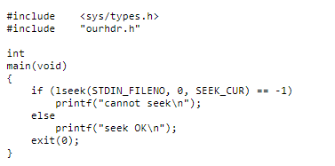
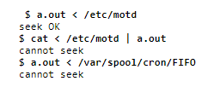
Output:
Notes:
Normally a file's current offset must be a nonnegative integer. It is possible, however, that certain devices could allow negative offsets. But for regular files the offset must be nonnegative. Since negative offsets are possible, we should be careful to compare the return value from lseek as being equal to or not equal to -1 and not test if it's less than 0.

